Slide 1
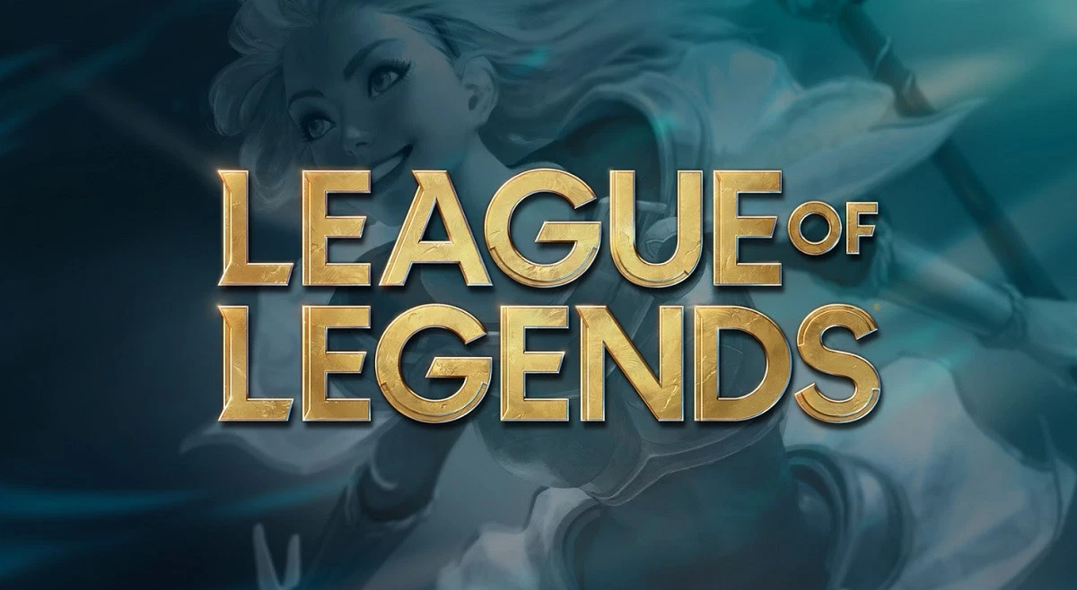
Capstone Project 1:
By John Bello

Slide 2

What is League of Legends?
League of Legends is classified as a Massive Online Battle Arena (MOBA). It is published and developed by Riot Games and holds a player base of approximately 80 million monthly players.
Tournaments
Seasonal Tournaments: LCS, LEC, LCK, LPL, PCS, VCS, LCL, TCL, CBLOL, LLA, LJL, OPL
International Tournaments: Mid-Season Invitational, World Championship

Slide 3
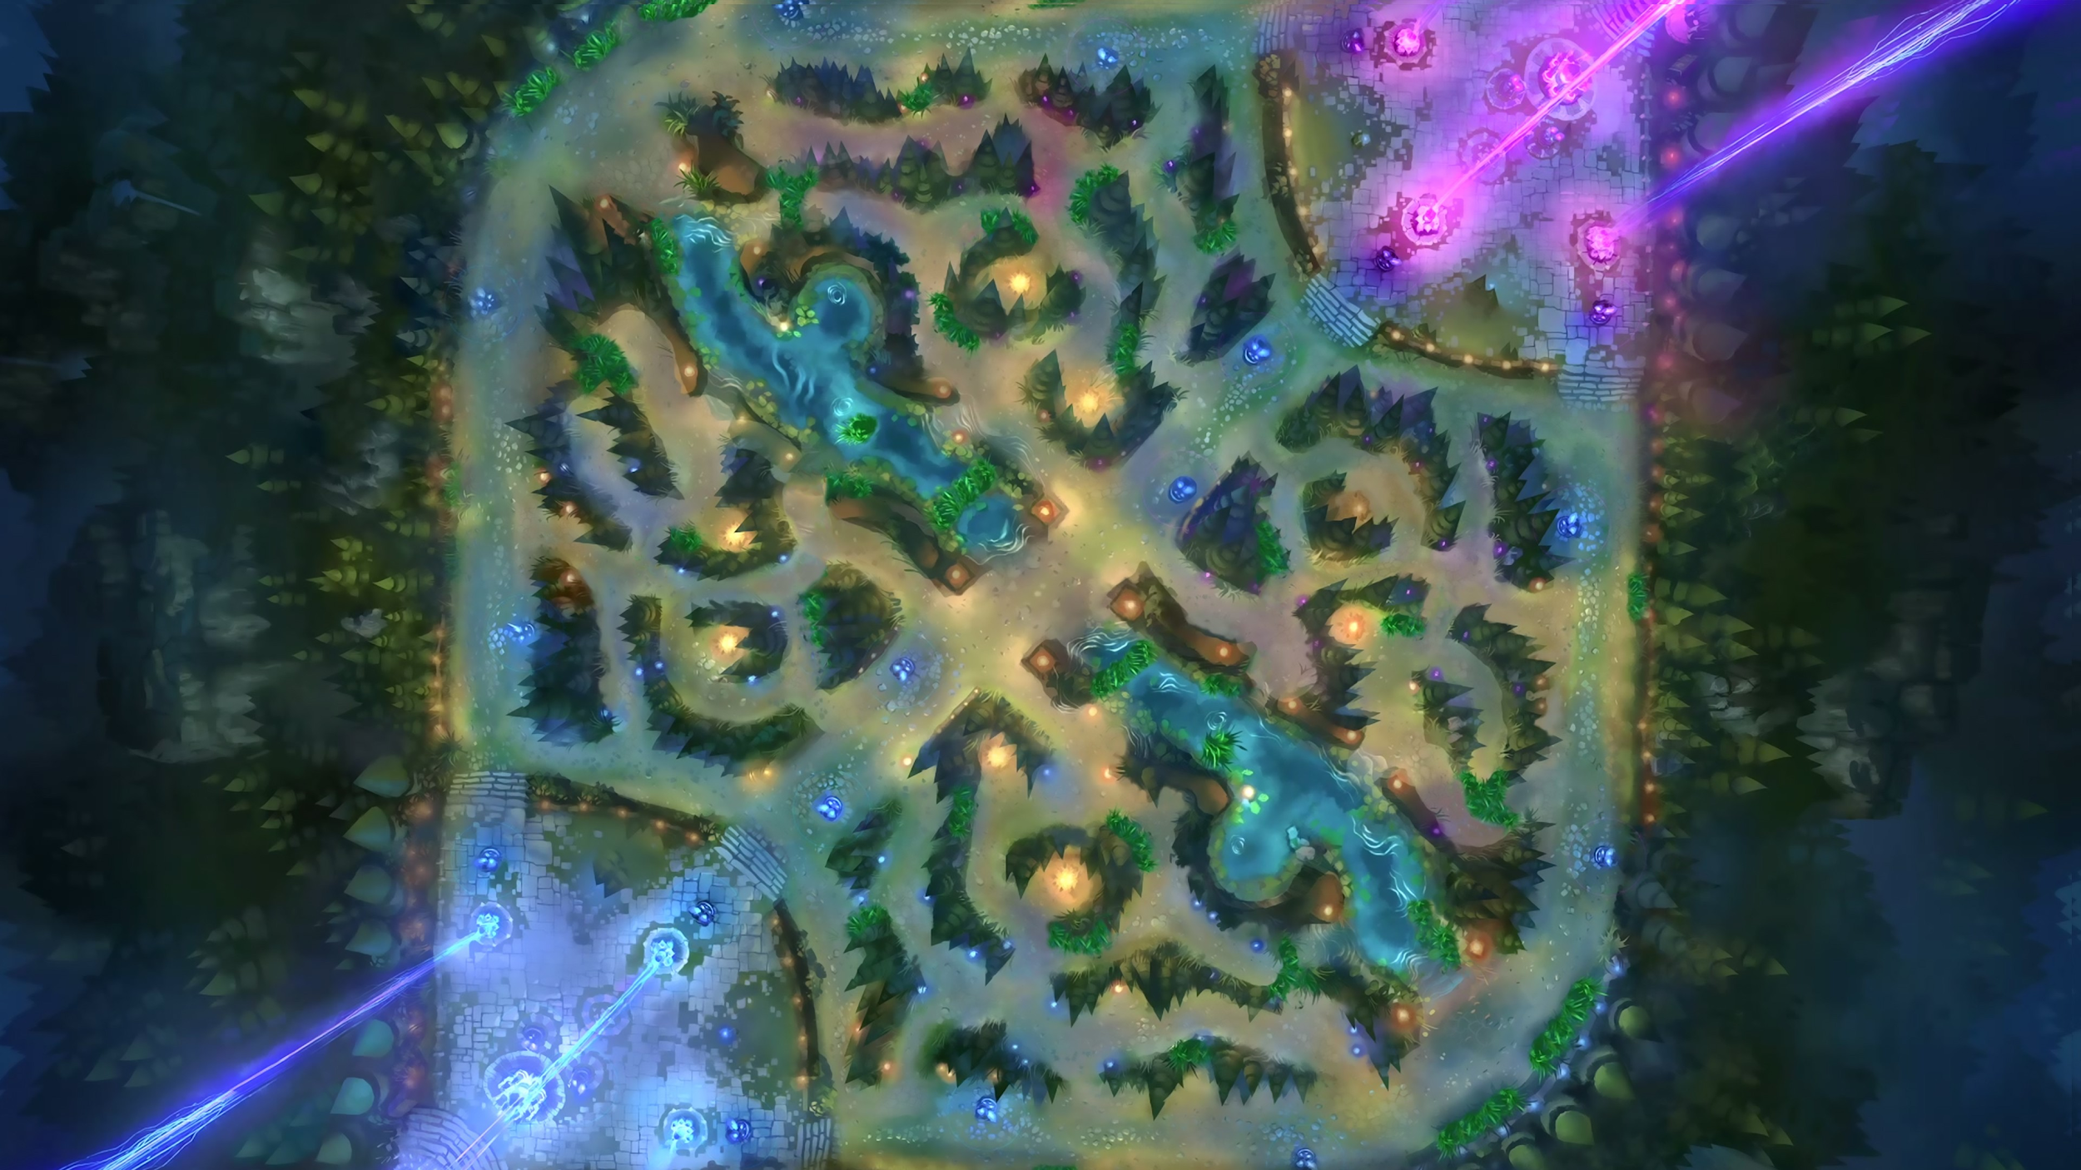
Game Structure
Three Lanes
Five Champions Per Side
Five Roles:
Top
Mid
Jungle
ADC
Support
Objectives:
Structures
Buffs
Inhibitors
Nexus

Slide 4
Problem Statement
Problem:
Create a classifier capable of predicting which team will win given game metrics.
Applications:
Influence game developer direction
Improve professional team practice

Slide 5
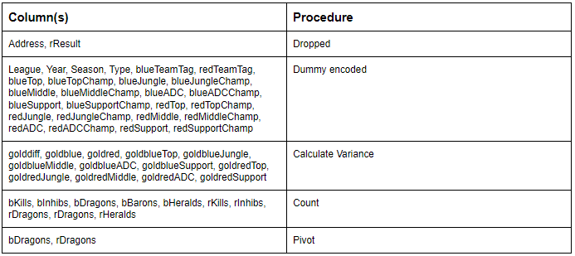
Data Wrangling Overview

Slide 6
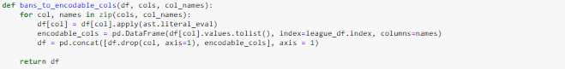
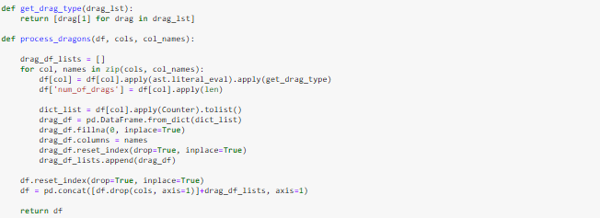
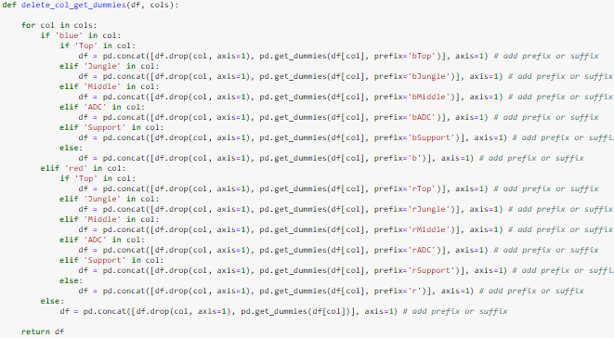
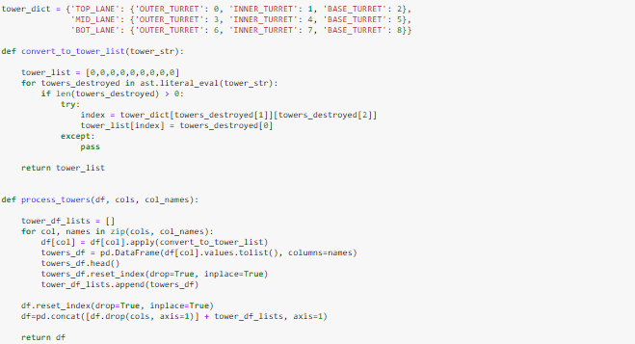
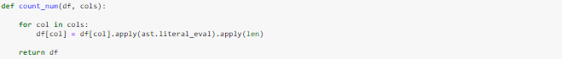
Data Wrangling Functions

Slide 7
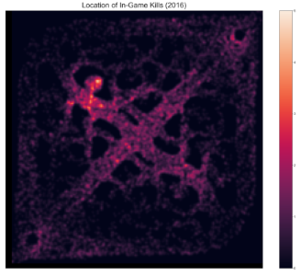
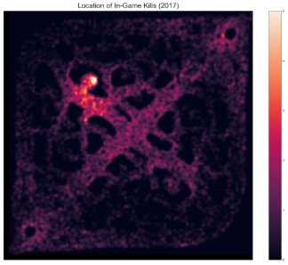
Data Analytics
In - Game Kills

Slide 8
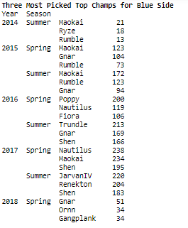
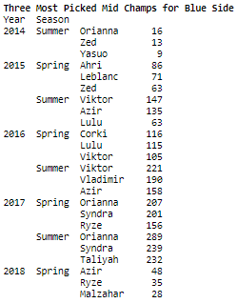
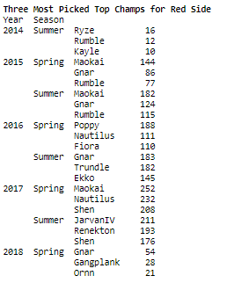
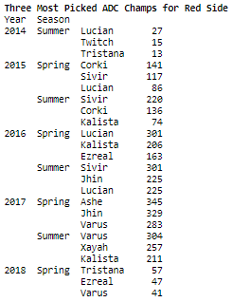
Most frequently picked champions

Slide 9
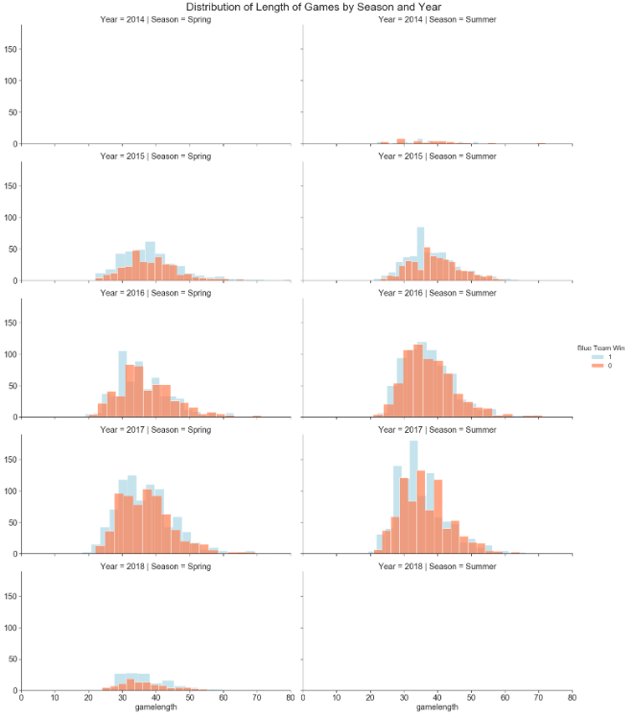
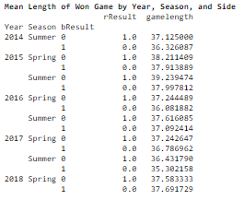
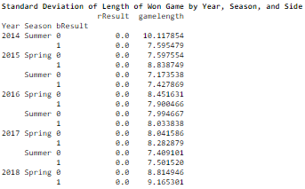
Game length

Slide 10
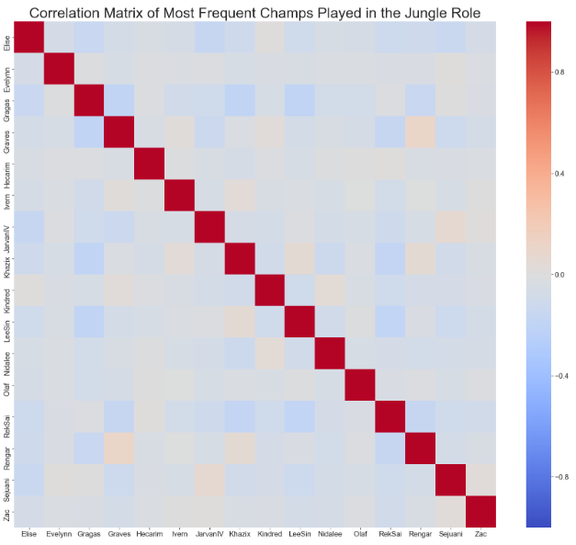
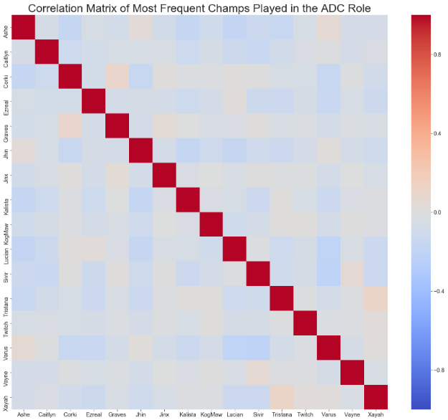
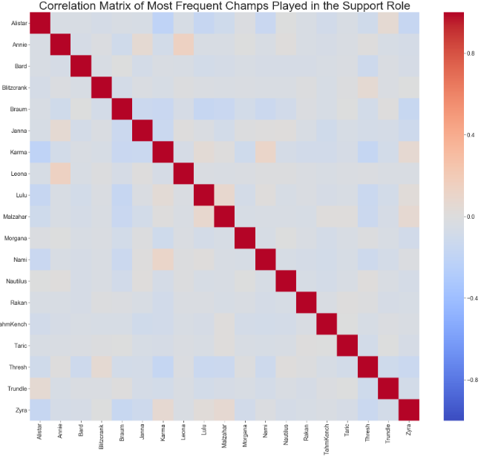
Correlation Plots

Slide 11
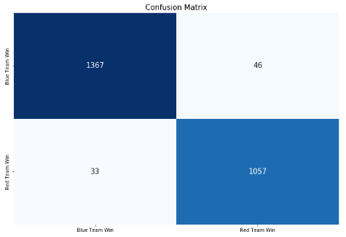
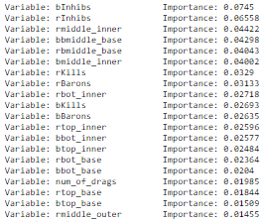
Building a model
Random Forest

Slide 12
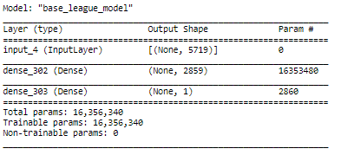
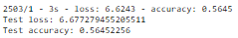
SVC
Neural Network

Slide 13
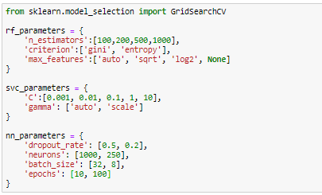
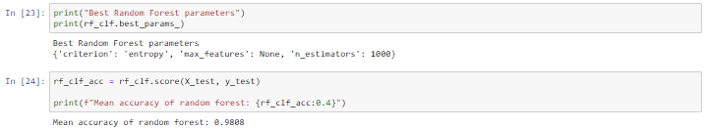
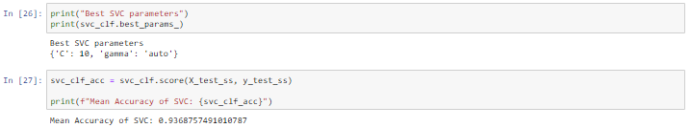
Improving the classifiers
Grid Search Parameters + Results (RF and SVC)

Slide 14
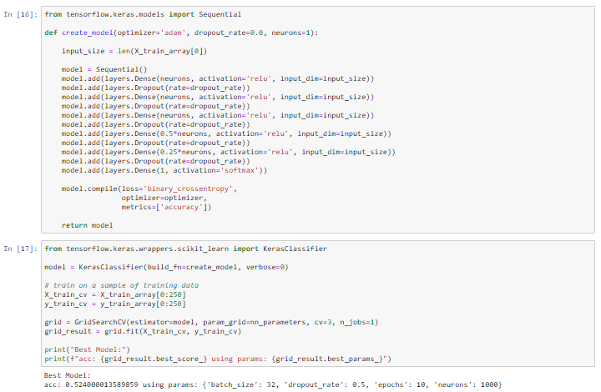
Neural Network

